Slide 1
RNA-seq data analysis: transcriptome assembly and differential expression analysis
Ashley Sawle (Ashley.Sawle@cruk.cam.ac.uk)
Guillermo Parada (guillermo.parada@sanger.ac.uk)

Slide 2
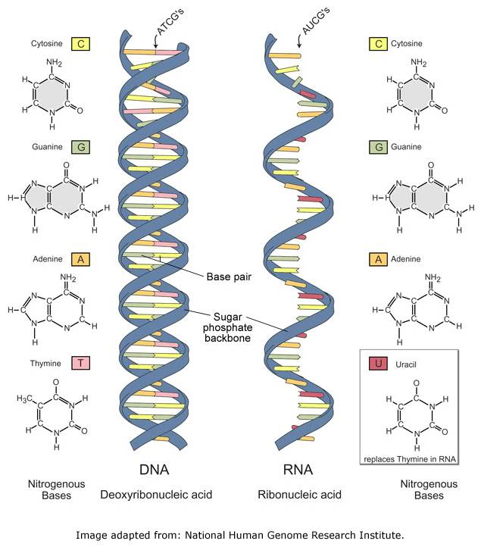
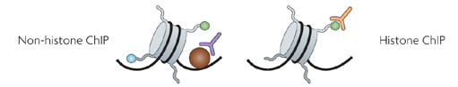
HTS Applications - Overview
DNA Sequencing
Genome Assembly
DNA methylation
ChIP-sequencing
Transcription Factor Binding Sites
RNA-sequencing
Transcriptome Assembly
Gene Expression
SNPs
Differential Expression
Chromatin Modification Regions

Slide 3
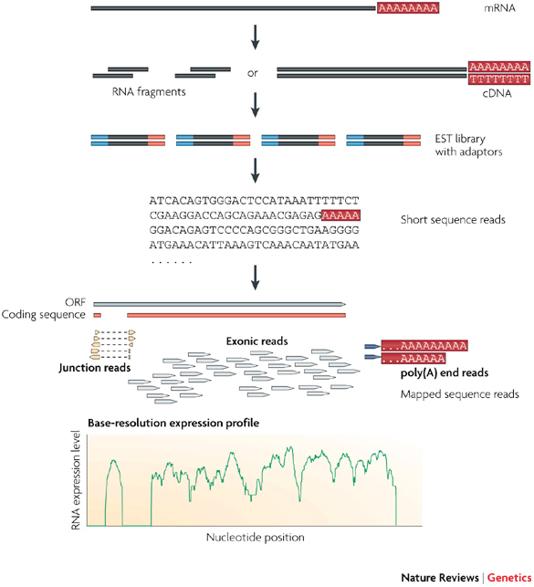
RNA-seq workflow
Library Preparation
Sequencing
Bioinformatics Analysis
Step1
Step2
Step3
Image adapted from: Wang, Z., et al. (2009), Nature Reviews Genetics, 10, 57–63.

Slide 4
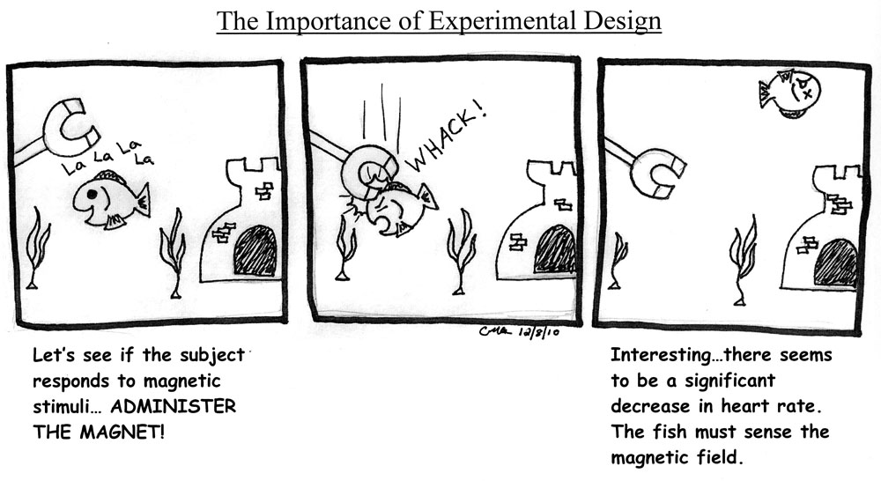
Designing the right experiment
Comic by Christine Ambrosino http://www.hawaii.edu/fishlab/Nearside.htm

Slide 5
Designing the right experiment
The design of the experiment is the first step and it is obviously determinant for all downstream analyses
You have to evaluate all the eventualities and limitations of available technologies, designing the experiment according to your goals

Slide 6
Designing the right experiment
COVERAGE: How many reads do we need?
The coverage is defined as C = ( R_{length} x R_{num} ) / A_{length}
R_{length} = length in nucleotides of the reads
R_{num} = number of sequenced reads
A_{length} = number of nucleotides of sequenced subject (genome, transcriptome, exome)
The amount of sequencing needed for a given sample is determined by the goals of the experiment and the nature of the RNA sample.
Sims et al. Nature Reviews Genetics 15, 121–132 (2014)

Slide 7
Designing the right experiment
READ LENGTH: long or short reads?
The answer depends again on the experiment:
Read length is inversely proportional to the multi-mappability of a read, in a sample of 50 nt reads there is a small fraction (<0.01 %) that can be mapped to multiple positions of the human genome.
GENOME RESEQUENCING
De novo TRANSCRIPTOME
TRANSCRIPTOME seq
ChIP seq

Slide 8
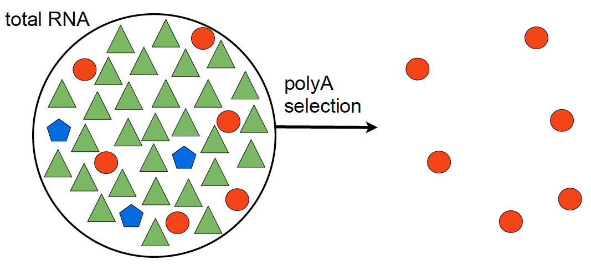
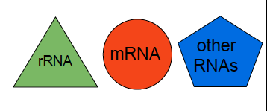
Step1 – Library Preparation

Slide 9
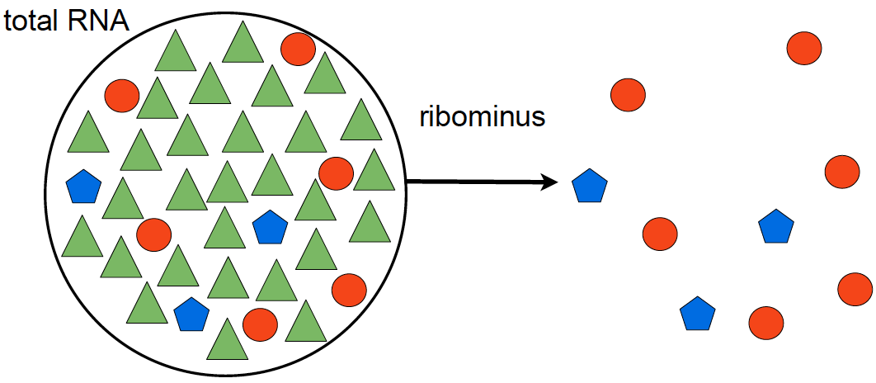
Step 1 – Library Preparation
polyA selection
ribominus selection
poly(A+)-transcripts:
mRNAs
immature microRNAs
snoRNAs
non poly(A+)-transcripts:
mRNAs
histone mRNAs
tRNAs
other small RNAs
Notes:
snoRNAs (synthesized by RNA polymerase II).
histone mRNAs (generated by RNA polymerase II)
small RNAs generated by RNA polymerase III

Slide 10
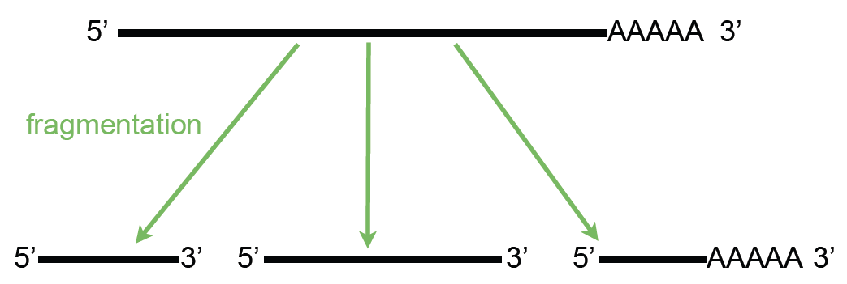
Step 1 – Library Preparation

Slide 11
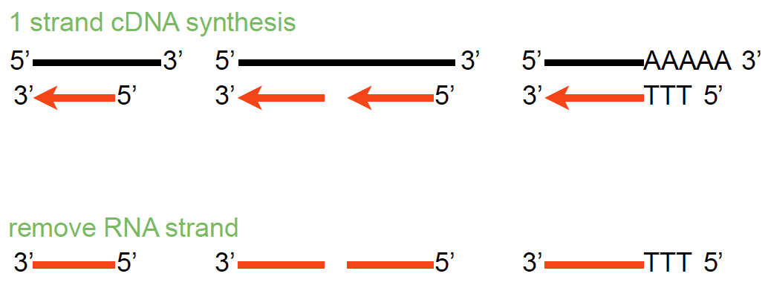
Step 1 – Library Preparation

Slide 12
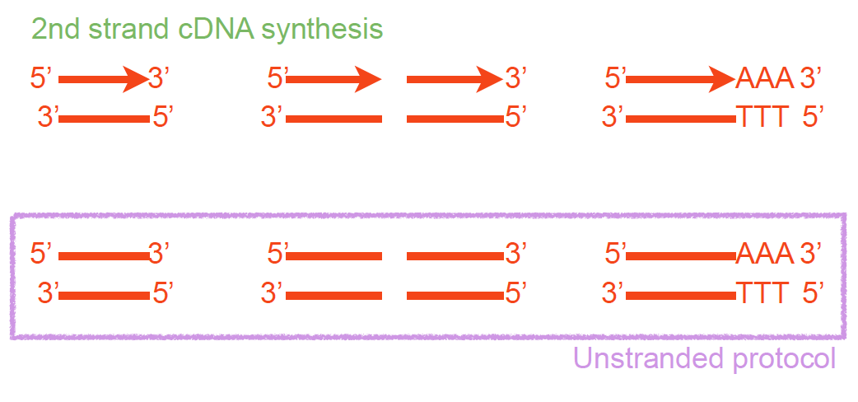
Step 1 – Library Preparation

Slide 13
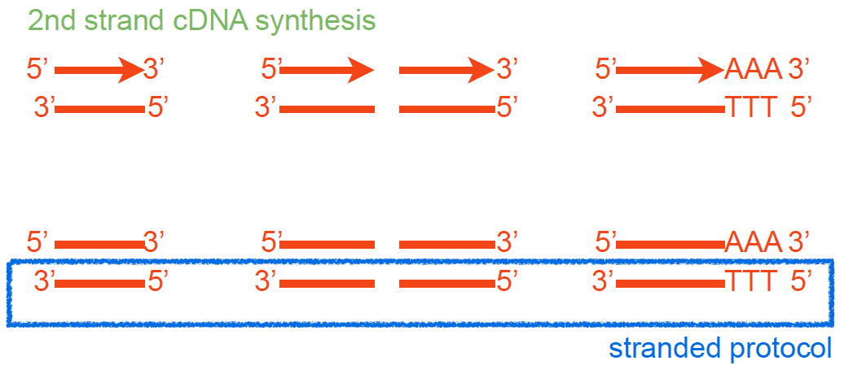
Step 1 – Library Preparation
Parkhomchuk, D., et al. (2009), Nucleic Acids Res, 37 (18), e123.

Slide 14
Step 1 – Library Preparation
Fragmented cDNA
cDNA with adaptors
Size selection
PCR amplification
Notes:
Popy T magnetic beads used for polyA selection
RNA Mg and heat ; alkaline hydrolysis or nebulization) hydrojet - 200 – 500bp and cDNA fragmentation (DNase I treatment or sonication).
End repair after RT, addd A, adaptor ( contain seq compliment to the oligo in the flowcells and seq primer site)

Slide 15
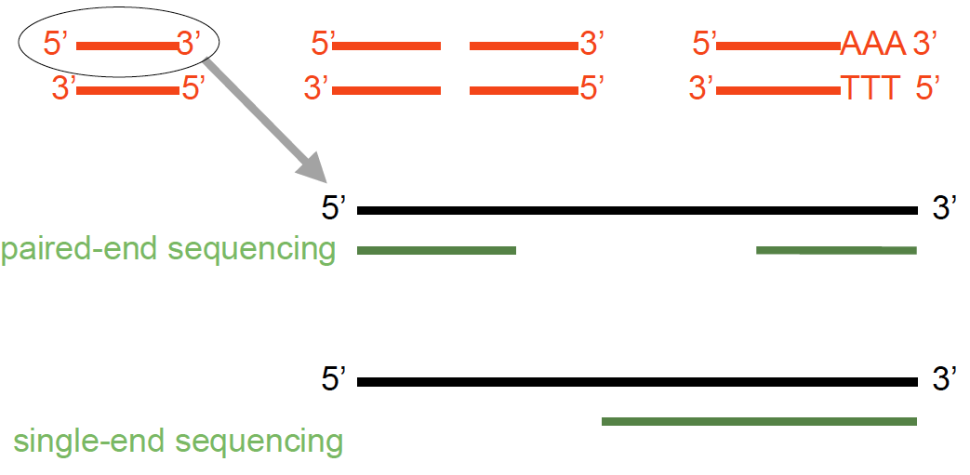
Step 2 – Sequencing

Slide 16
Single- vs paired-end sequencing
my_sequence.fastq
@HWI-BRUNOP16X_0001:1:1:1466:1018#0/1
AAGGAAGTGCTTGTCTGGCTAACACAGCNAGNCACGTGAC
+
aVfbe`^^^_TTTSSdffffdfffabbZbbfebafbbbbb
SE
my_sequence_1.fastq
@HWI-BRUNOP16X_0001:1:1:1278:989#0/1
NAAATTTCGAATTTCTGTGAAGTAAGCATCTTCTTTGTCAT
+
BJJGGKIINN^^^^^QQNTUQOOTTTRTOTY^^Y^\\^^^\
PE
my_sequence_2.fastq
@HWI-BRUNOP16X_0001:1:1:1278:989#0/2
AACCCACACAGGAGAGCAGCCTTACAGATGCAAATACTGTG
+
]K___fffffggghgeggggggdgggggfgggggegggghh
Notes:
Now it’s important to distinguish between SE and PE data
SE data is generated just as we described
The main difference with PE is that here we are using two different adaptors
And we are sequencing the molecule from both ends (and we know which end is)
This has the main advatage that we can obtain more information without having to sequence longer reads
For RNA-seq though PE data provides more information: splicing events
Also, for DNA-seq, SVs
In terms of output, different fastq files
Read names
Although the pipeline is the same, we’ll probably have to hange some options in the software we execute, as we’ll see

Slide 17
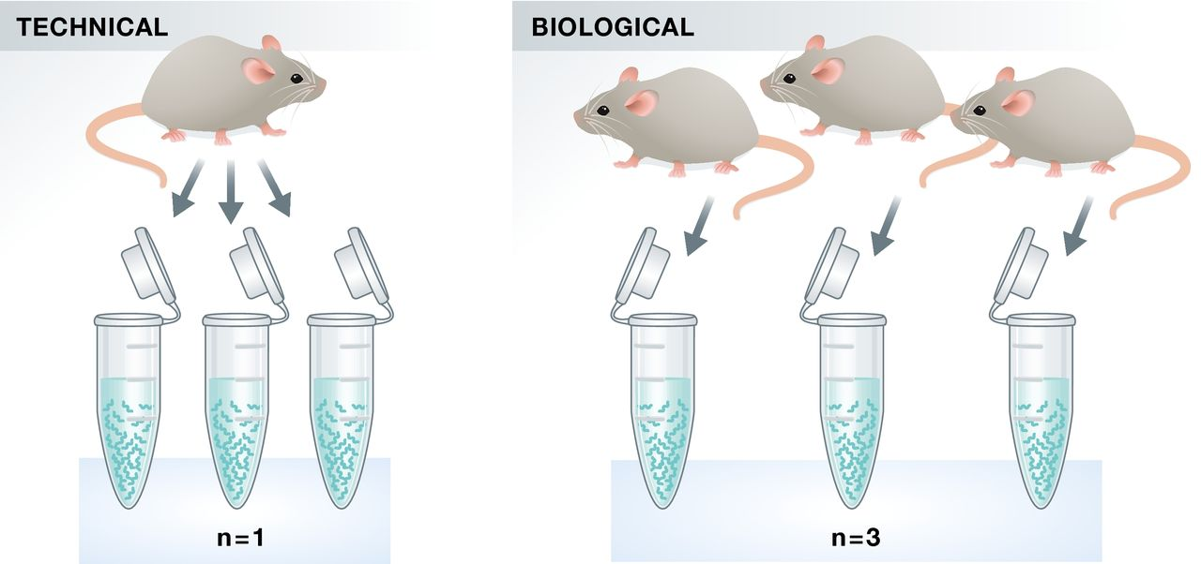
Replicates – do I need them?
10.15252/embj.201592958 | Published online 21.09.2015 The EMBO Journal (2015) e201592958

Slide 18

Replicates – do I need them?
Technical
Same biological sample – same conditions
measure technical variation
Library preparation
and sequencing
Technical replicate1
Library preparation
and sequencing
Technical replicate2

Slide 19
Replicates – do I need them?
Biological
Different biological sample – same conditions
measure biological variation
Library preparation
and sequencing
Biological replicate1
Library preparation
and sequencing
Biological replicate2

Slide 20
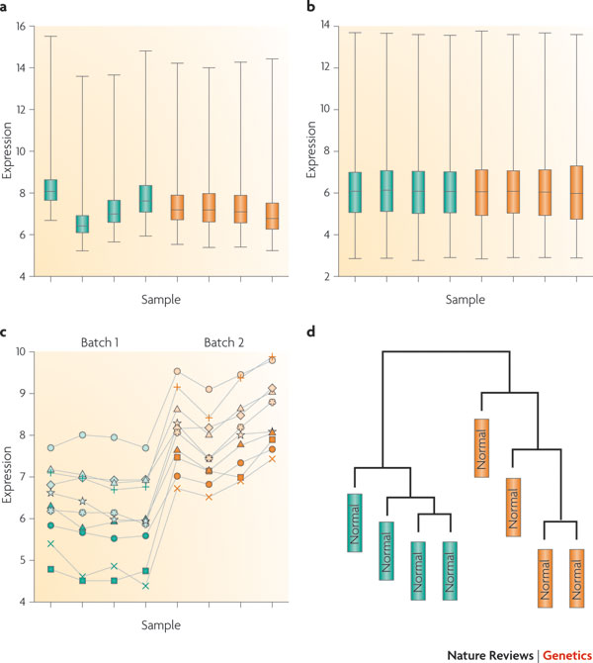
Controlling batch effects
Batch effects are sub-groups of measurements that have qualitatively different behavior across conditions and are unrelated to the biological or scientific variables in a study
Leek et al. Nature Reviews Genetics 11, 733-739 (October 2010) | doi:10.1038/nrg2825
Notes:
*What is a flow cell, what is a lane
Imagine we have 4 samples, and we want to generate 8 replicates for each of them
One of the first experimental designs that might come to our mind is this one: 1 flow cell for each sample
This is a very dangerous design, because if we were to perform DE analysis on its results,
We wouldn’t be sure if the differences that we detect are because of the conditions or because of the fact that the samples were sequenced separately
In other words, we are introducing a bias and making our lifes more difficult

Slide 21
Controlling batch effects
Library
preparation
Sequencing
Analysis
Library
preparation
Sequencing
Analysis
Library
preparation
Sequencing
Analysis

Slide 22
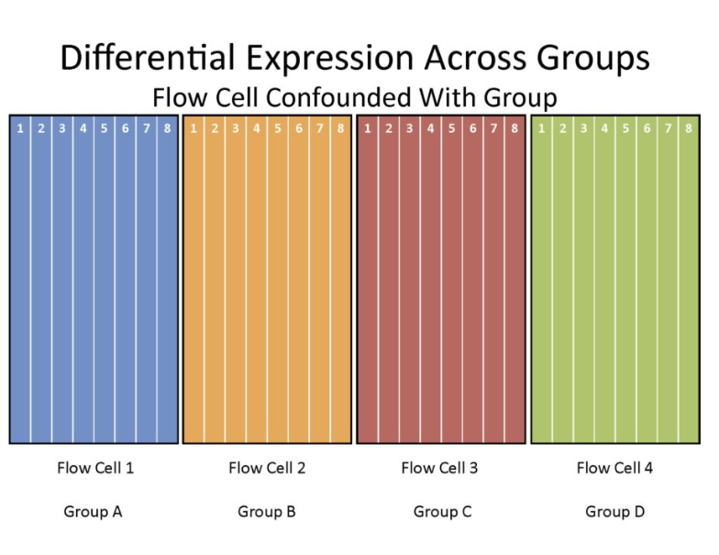
Example of experimental design
Notes:
*What is a flow cell, what is a lane
Imagine we have 4 samples, and we want to generate 8 replicates for each of them
One of the first experimental designs that might come to our mind is this one: 1 flow cell for each sample
This is a very dangerous design, because if we were to perform DE analysis on its results,
We wouldn’t be sure if the differences that we detect are because of the conditions or because of the fact that the samples were sequenced separately
In other words, we are introducing a bias and making our lifes more difficult

Slide 23
Example of experimental design
Notes:
*What is a flow cell, what is a lane
Imagine we have 4 samples, and we want to generate 8 replicates for each of them
One of the first experimental designs that might come to our mind is this one: 1 flow cell for each sample
This is a very dangerous design, because if we were to perform DE analysis on its results,
We wouldn’t be sure if the differences that we detect are because of the conditions or because of the fact that the samples were sequenced separately
In other words, we are introducing a bias and making our lifes more difficult

Slide 24
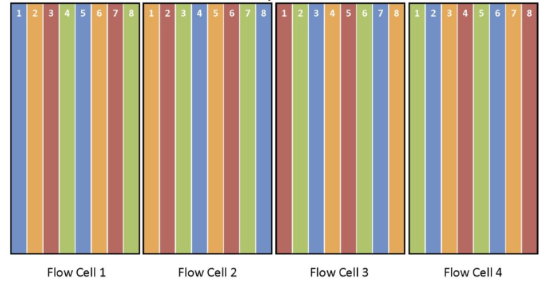
...better experimental design
Randomize samples with respect to the flow cell
Notes:
A more correct approach would be this one, in which the replicates have been randomly distributed across the 4 flow cells
However, if we want to be very picky and have a closer look, we can still see that there might be a lane effect.
For example,
Blue 1 and 5 vs 2 and 6 – are the differences due to the conditions or to the different lane within the flow cell?

Slide 25
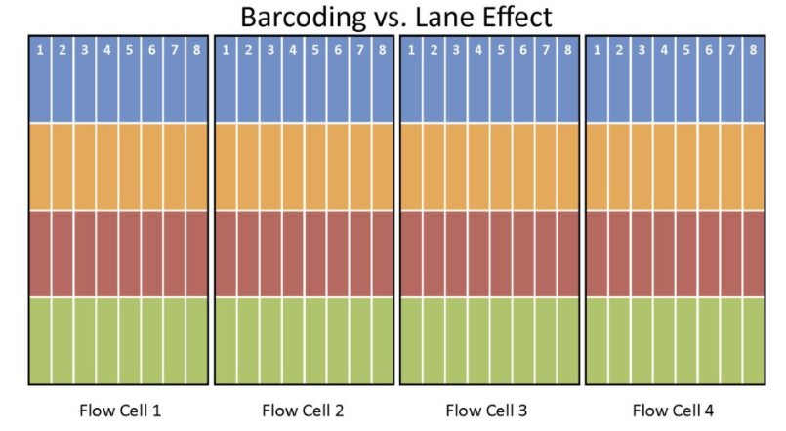
...even better experimental design
Notes:
An even better experimental design would be this one
Barcode all the samples and let them cover all the lanes in all the flowcells

Slide 26
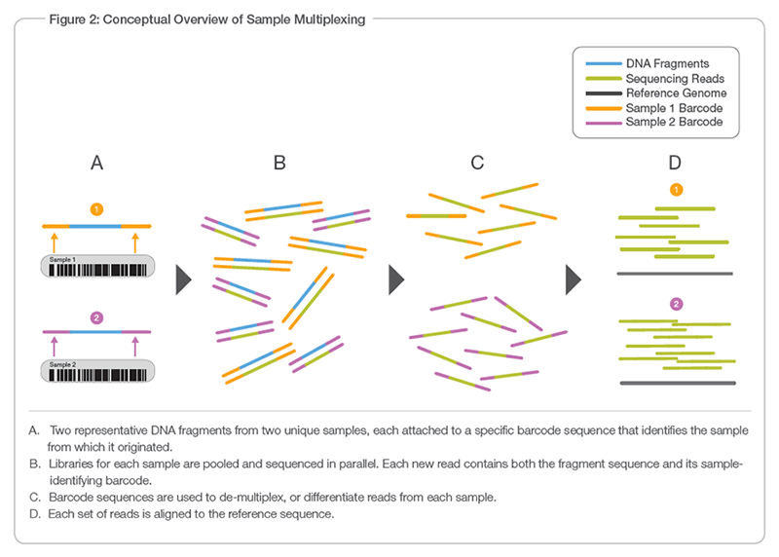
Multiplexing to prevent batch effects

Slide 27
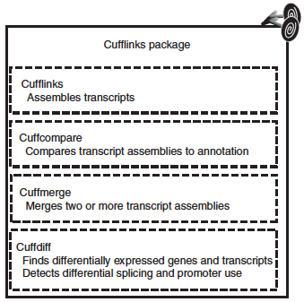
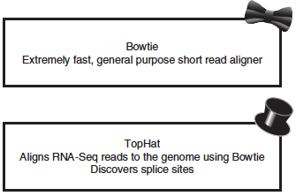
Step 3 - RNA-seq analysis workflow*
* if the reference genome is available
QC
Alignment
Transcriptome Assembly
Differential Expression
Trapnell, C., et al. (2012), Nature protocols, 7(3), 562–578.

Slide 28
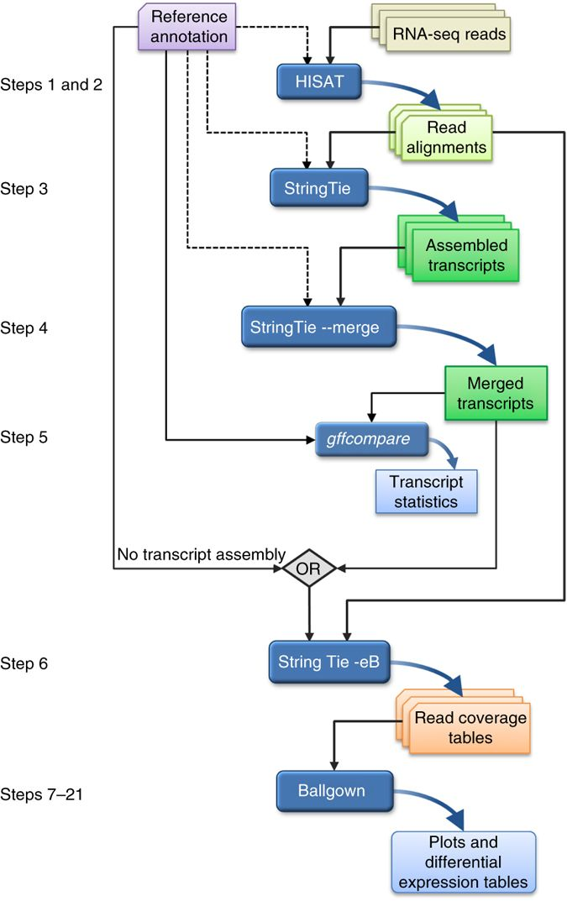
Step 3 - RNA-seq analysis workflow* (UPDATED)
Pertea, M., et al. (2016), Nature protocols

Slide 29
Quality Control
Essential for downstream analysis.
Decide sensibly on which data can be filtered out from the downstream analysis.
You might find yourself going back to that step several times during downstream analysis.

Slide 30
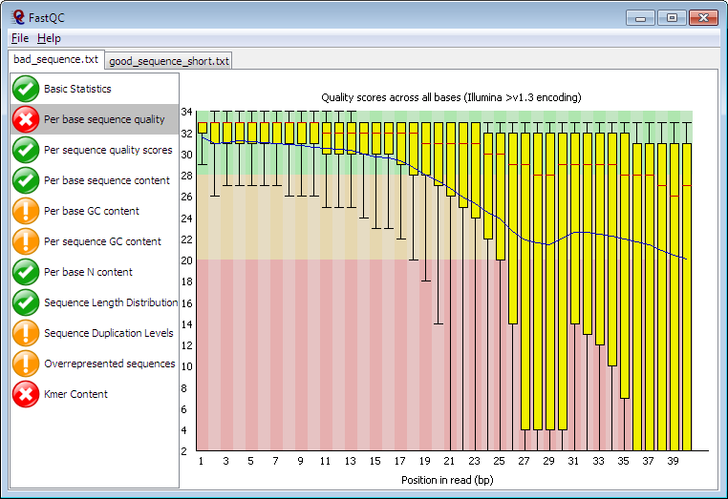
FastQC

Slide 31
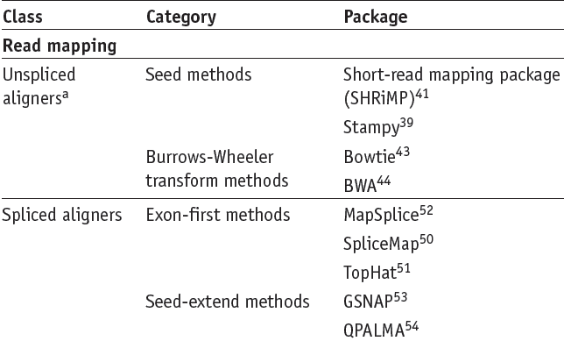
Alignment
Garber, M., et al. (2011), Nature Methods, 8(6), 469–477.

Slide 32
Aliments are reported as SAM
Most aligners used their own format to output the alignments.
Hence, downstream comparisons and analyses were difficult to perform.
To resolve this issue, Li et al. have suggested a standardized file format: the Sequence Alignment/Map (SAM) format
SAM is currently the standard format for alignment results
SAMtools is a suite of programs for interacting with high-throughput sequencing data. (http://www.htslib.org/)

Slide 33
Annotation and alignment files: SAM
SAM FORMAT
A SAM file consists of two parts:
• Header
-contains meta data (source of the reads, ref. genome, aligner, etc.)
-Header lines necessarily start with “@”.
-Header fields have standardized two-letter codes for easy parsing
• Alignment section
-A tab-separated table with at least 11 columns
-Each line describes one alignment

Slide 34
@HD VN:1.4 SO:coordinate
@SQ SN:CHROMOSOME_I LN:15072423
@SQ SN:CHROMOSOME_II LN:15279345
@SQ SN:CHROMOSOME_III LN:13783700
@SQ SN:CHROMOSOME_IV LN:17493793
@SQ SN:CHROMOSOME_V LN:20924149
@SQ SN:CHROMOSOME_X LN:17718866
@SQ SN:CHROMOSOME_MtDNA LN:13794
@SQ SN:sensor_piRNA_mjIs144 LN:1663
@CO user command line: /Users/berkyurekahmetcan/Desktop/Data_analysis/STAR-master/bin/MacOSX_x86_64/STAR --runThreadN 4 --genomeDir /Users/berkyurekahmetcan/Desktop/Data_analysis/pichip/totalRNA/data/reference/ --readFilesIn "/Users/berkyurekahmetcan/Dropbox (ericmiskalab)/cambridge-UK/NGS/piChIP/totalRNA/outfilterMultimapper_500/elution/wt1/elution_wt_1.fastq.gz" --readFilesCommand "gunzip -c" --outSAMtype BAM SortedByCoordinate --outMultimapperOrder Random --outFilterMultimapNmax 500 --alignIntronMax 1
L180:540:HTMV2BCXY:1:1112:6120:12935 0 CHROMOSOME_I 3745 255 49M * 0 0 TAGAGGGTTAGACCCAAAATTCAGCCCGCGAAGGCATGACGTCAGCGCG GGGGGGIIIIIGIIIIIIIIIIGIIIIIIIIIIIIIIIIIIIIIIIIII NH:i:1 HI:i:1 AS:i:44 nM:i:2
L180:540:HTMV2BCXY:1:1113:17520:75431 0 CHROMOSOME_I 3745 255 49M * 0 0 TAGAGGGTTAGACCCAAAATTCAGCCCGCGAAGGCATGACGTCAGCGCG GGGGGIIIIIGIIIIIIIIIIIIGIIIIIIIIGIIIIIIIIIIIGIIII NH:i:1 HI:i:1 AS:i:44 nM:i:2
L180:540:HTMV2BCXY:1:2111:6429:77948 0 CHROMOSOME_I 3745 255 49M * 0 0 TAGAGGGTTAGACCCAAAATTCAGCCCGCGAAGGCATGACGTCAGCGCG GGGGGIIIIIIIIIIIIIIIIIIIIIIIIIIIIIIIIIIIIIIIIIIII NH:i:1 HI:i:1 AS:i:44 nM:i:2
L180:540:HTMV2BCXY:1:2202:18496:19290 0 CHROMOSOME_I 3745 255 49M * 0 0 TAGAGGGTTAGACCCAAAATTCAGCCCGCGAAGGCATGACGTCAGCGCG GGGGGIIIIIIIIIIIIIIIIIIGIIIIIIIIIGIIIIIIIIIGIIIII NH:i:1 HI:i:1 AS:i:44 nM:i:2
L180:540:HTMV2BCXY:1:2205:19372:73018 0 CHROMOSOME_I 3745 255 49M * 0 0 TAGAGGGTTAGACCCAAAATTCAGCCCGCGAAGGCATGACGTCATCGCG GGGGGIIIIIGIIIIIIIIIIIIIIIIIIIIIIIIIIIIIIIII.GGII NH:i:1 HI:i:1 AS:i:42 nM:i:3
L180:540:HTMV2BCXY:1:2213:1720:60756 0 CHROMOSOME_I 3745 255 49M * 0 0 TAGAGGGTTAGACCCAAAATTCAGCCCGCGAAGGCATGACGTCAGCGCG
Header
Aligments

Slide 35
Annotation and alignment files: SAM
SAM FORMAT
1)QNAME: ID of the read (“query”)
2)FLAG: alignment flags
3)RNAME: ID of the reference (typically: chromosome name)
4)POS: Position in reference (1-based, left side)
5)MAPQ: Mapping quality (as Phred score)
6)CIGAR: Alignment description (gaps etc.) in CIGAR format
7)MRNM: Mate reference sequence name [for paired end data]
8)MPOS: Mate position [for paired end data]
9)ISIZE: inferred insert size [for paired end data]
10)SEQ: sequence of the read
11)QUAL: quality string of the read
N)EXTRA fields

Slide 36
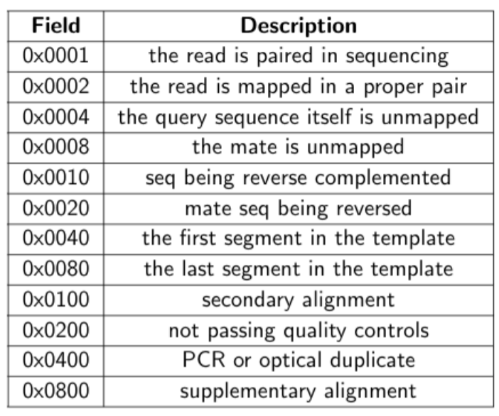
Annotation and alignment files: SAM
SAM FORMAT
The flag (F2) is a number that gives precise information about the alignment:
https://broadinstitute.github.io/picard/explain-flags.html
The information can be summed: E.G. an unpaired read that aligns to the reverse reference strand will have flag 16. A paired-end read that aligns and is the first mate in the pair will have flag 83 (= 64 + 16 + 2 + 1).

Slide 37
Annotation and alignment files: SAM
SAM FORMAT
The CIGAR (F6) is a representation of the alignment:
RefPos: 1 2 3 4 5 6 7 8 9 10 11 12 13 14 15 16 17 18 19
Reference: C C A T A C T G A A C T G A C T A A C
Read: ACTAGAATGACT
RefPos: 1 2 3 4 5 6 7 8 9 10 11 12 13 14 15 16 17 18 19
Reference: C C A T A C T G A A C T G A C T A A C
Read: A C T A G A A T G A C T
POS: 5
CIGAR: 3M1I3M1D5M

Slide 38
Annotation and alignment files: SAM
SAMtools
SAMtools are a set of simple tools useful to:
-convert between SAM and BAM
-SAM: a human-readable text file
-BAM: a binary version of a SAM file, suitable for fast processing
-sort and merge SAM files
-index SAM and FASTA files for fast access
-view alignments (“tview”)
-produce a “pile-up”, i.e., a file showing
-local coverage
-mismatches and consensus calls
-indels

Slide 39
Transcriptome assembly
Genome
paired reads
spliced reads

Slide 40
Transcriptome assembly
STEP 1: Identify fragments that cannot have originated from the same transcript
(Hint: Use spliced reads)
Genome
paired reads
spliced reads

Slide 41
Transcriptome assembly
STEP 1: Identify fragments that cannot have originated from the same transcript
(Hint: Use spliced reads)
Genome
paired reads
spliced reads

Slide 42
Transcriptome assembly
STEP 2: Connect ‘incompatible’ fragments into directed graphs
(Hint: Use paired reads)
Genome
paired reads
spliced reads

Slide 43
Transcriptome assembly
STEP 3: Assemble transcripts
STEP 4: Quantify transcript expression
Genome
Transcript A
Transcript B

Slide 44
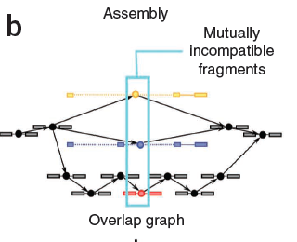
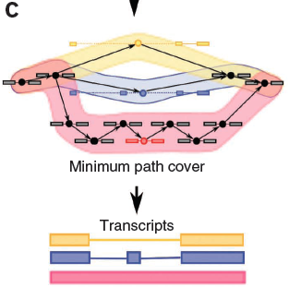
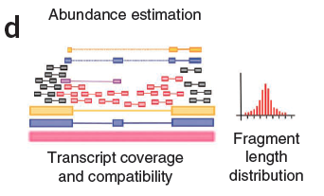
Cufflinks
Transcript abundance is estimated in FPKMs (Fragments Per Kilobase of exon per Million fragments mapped)
Trapnell, C., et al. (2010), Nature biotechnology, 28(5), 511–515
Notes:
a minimal set of paths that cover all the fragments in the overlap graph by finding the largest set of reads with the property that no two could have originated from the same isoform.
Cufflinks estimates transcript abundances using a statistical model in which the probability of observing each fragment is a linear function of the abundances of the transcripts from which it could have originated. Because only the ends of each fragment are sequenced, the length of each may be unknown. Assigning a fragment to different isoforms often implies a different length for it. Cufflinks incorporates the distribution of fragment lengths to help assign fragments to isoforms.
it uses a negative binomial model estimated from data to obtain variance estimates from which p-values are computed.

Slide 45
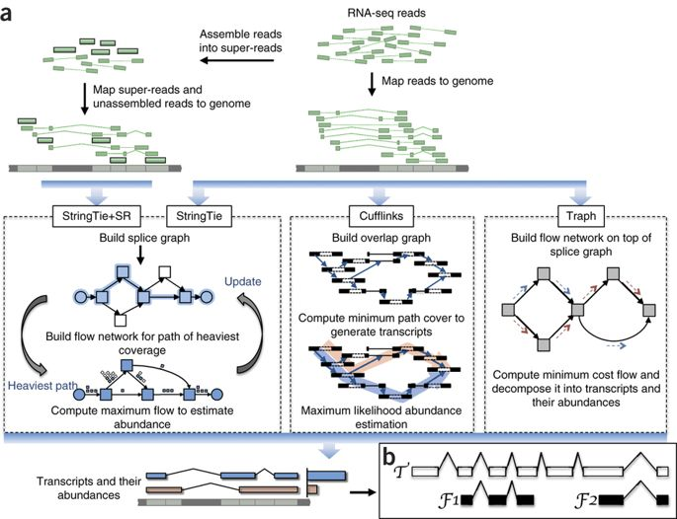
StringTie

Slide 46
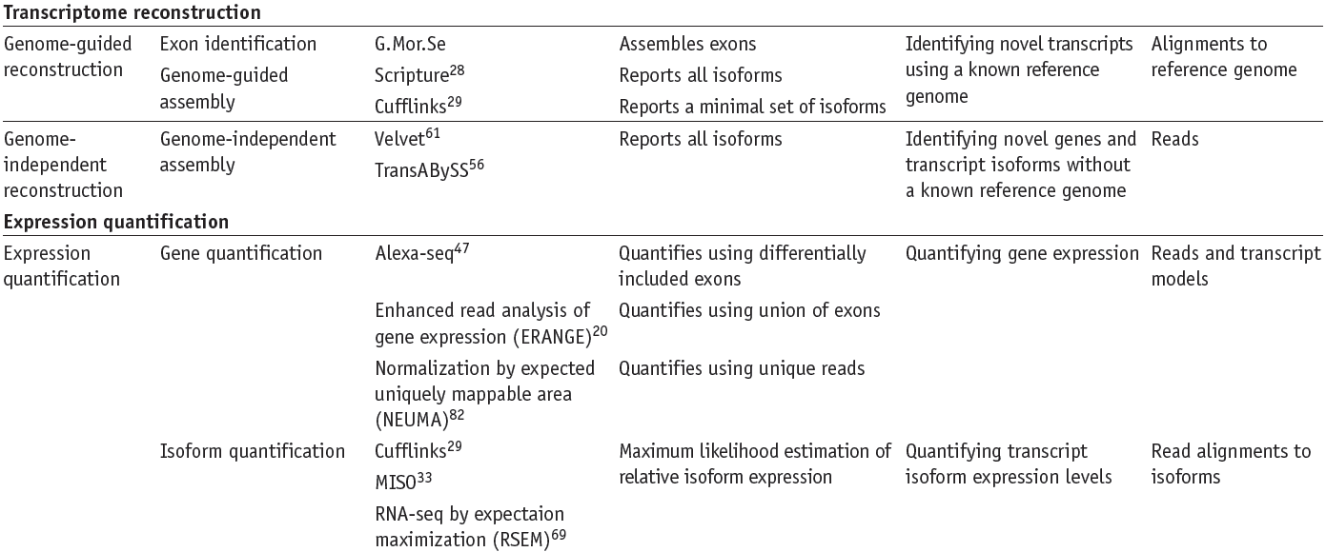
Transcriptome Assembly & Isoform quantification Tools
Garber, M., et al. (2011), Nature Methods, 8(6), 469–477.
Notes:
a minimal set of paths that cover all the fragments in the overlap graph by finding the largest set of reads with the property that no two could have originated from the same isoform.
Cufflinks estimates transcript abundances using a statistical model in which the probability of observing each fragment is a linear function of the abundances of the transcripts from which it could have originated. Because only the ends of each fragment are sequenced, the length of each may be unknown. Assigning a fragment to different isoforms often implies a different length for it. Cufflinks incorporates the distribution of fragment lengths to help assign fragments to isoforms.

Slide 47
Reference sequence: NOT FOUND
De novo transcriptome assembly
Requirements:
Deep sequencing and/or longer reads
Thorough quality control
Large memory/Multiple processors
Patience
Tools:
Velvet/Oases: http://www.ebi.ac.uk/~zerbino/oases/
Trinity: http://trinityrnaseq.sourceforge.net/
Trans-ABySS: http://www.bcgsc.ca/platform/bioinfo/software/trans-abyss
MIRA, CLC etc.

Slide 48
Normalised expression values
For gene/isoform length
Gene A
Gene B
Gene | Raw reads | Length | Normalised Reads
A | 10 | 2 | 5
B | 5 | 1 | 5
Notes:
a minimal set of paths that cover all the fragments in the overlap graph by finding the largest set of reads with the property that no two could have originated from the same isoform.
Cufflinks estimates transcript abundances using a statistical model in which the probability of observing each fragment is a linear function of the abundances of the transcripts from which it could have originated. Because only the ends of each fragment are sequenced, the length of each may be unknown. Assigning a fragment to different isoforms often implies a different length for it. Cufflinks incorporates the distribution of fragment lengths to help assign fragments to isoforms.
it uses a negative binomial model estimated from data to obtain variance estimates from which p-values are computed.

Slide 49
Normalised expression values
For total number of mapped reads
Gene A
Condition | Raw reads | Total mapped reads | Normalised Reads
x | 10 | 1000 | 0.01
z | 5 | 500 | 0.01
Condition x
Condition z
Gene A
Notes:
a minimal set of paths that cover all the fragments in the overlap graph by finding the largest set of reads with the property that no two could have originated from the same isoform.
Cufflinks estimates transcript abundances using a statistical model in which the probability of observing each fragment is a linear function of the abundances of the transcripts from which it could have originated. Because only the ends of each fragment are sequenced, the length of each may be unknown. Assigning a fragment to different isoforms often implies a different length for it. Cufflinks incorporates the distribution of fragment lengths to help assign fragments to isoforms.
it uses a negative binomial model estimated from data to obtain variance estimates from which p-values are computed.

Slide 50
FPKM (Fragment Per Kilobase Million)
I STEP: normalize by depth
GENE | REP1 | REP2 | REP3
A1 (2kb) | 10 | 12 | 30
A2 (4kb) | 20 | 25 | 60
A3 (1kb) | 5 | 8 | 15
A4 (10kb) | 0 | 0 | 1
Notes:
a minimal set of paths that cover all the fragments in the overlap graph by finding the largest set of reads with the property that no two could have originated from the same isoform.
Cufflinks estimates transcript abundances using a statistical model in which the probability of observing each fragment is a linear function of the abundances of the transcripts from which it could have originated. Because only the ends of each fragment are sequenced, the length of each may be unknown. Assigning a fragment to different isoforms often implies a different length for it. Cufflinks incorporates the distribution of fragment lengths to help assign fragments to isoforms.
it uses a negative binomial model estimated from data to obtain variance estimates from which p-values are computed.

Slide 51
FPKM (RPKM)
I STEP: normalize by depth
GENE | REP1 | REP2 | REP3
A1 (2kb) | 10 | 12 | 30
A2 (4kb) | 20 | 25 | 60
A3 (1kb) | 5 | 8 | 15
A4 (10kb) | 0 | 0 | 1
Sum all the counts
Scale by 1M (10)
35 45 106
3.5 4.5 10.6
Notes:
a minimal set of paths that cover all the fragments in the overlap graph by finding the largest set of reads with the property that no two could have originated from the same isoform.
Cufflinks estimates transcript abundances using a statistical model in which the probability of observing each fragment is a linear function of the abundances of the transcripts from which it could have originated. Because only the ends of each fragment are sequenced, the length of each may be unknown. Assigning a fragment to different isoforms often implies a different length for it. Cufflinks incorporates the distribution of fragment lengths to help assign fragments to isoforms.
it uses a negative binomial model estimated from data to obtain variance estimates from which p-values are computed.

Slide 52
FPKM (RPKM)
II STEP: divide counts by scaling factor
3.5 4.5 10.6
SCALING FACTOR
GENE | REP1 | REP2 | REP3
A1 (2kb) | 2.86 | 2.67 | 2.83
A2 (4kb) | 5.71 | 5.56 | 5.66
A3 (1kb) | 1.43 | 1.78 | 1.43
A4 (10kb) | 0 | 0 | 0.09
COUNTS -> FPM
Notes:
a minimal set of paths that cover all the fragments in the overlap graph by finding the largest set of reads with the property that no two could have originated from the same isoform.
Cufflinks estimates transcript abundances using a statistical model in which the probability of observing each fragment is a linear function of the abundances of the transcripts from which it could have originated. Because only the ends of each fragment are sequenced, the length of each may be unknown. Assigning a fragment to different isoforms often implies a different length for it. Cufflinks incorporates the distribution of fragment lengths to help assign fragments to isoforms.
it uses a negative binomial model estimated from data to obtain variance estimates from which p-values are computed.

Slide 53
FPKM (RPKM)
III STEP: divide counts by length (kb)
GENE | REP1 | REP2 | REP3
A1 (2kb) | 1.43 | 1.33 | 1.42
A2 (4kb) | 1.43 | 1.39 | 1.42
A3 (1kb) | 1.43 | 1.78 | 1.42
A4 (10kb) | 0 | 0 | 0.009
FPM -> FPKM
Notes:
a minimal set of paths that cover all the fragments in the overlap graph by finding the largest set of reads with the property that no two could have originated from the same isoform.
Cufflinks estimates transcript abundances using a statistical model in which the probability of observing each fragment is a linear function of the abundances of the transcripts from which it could have originated. Because only the ends of each fragment are sequenced, the length of each may be unknown. Assigning a fragment to different isoforms often implies a different length for it. Cufflinks incorporates the distribution of fragment lengths to help assign fragments to isoforms.
it uses a negative binomial model estimated from data to obtain variance estimates from which p-values are computed.

Slide 54
TPM (Transcripts Per Million)
TPM is similar to FPKM and RPKM but it is calculated in a
different order
GENE | REP1 | REP2 | REP3
A1 (2kb) | 10 | 12 | 30
A2 (4kb) | 20 | 25 | 60
A3 (1kb) | 5 | 8 | 15
A4 (10kb) | 0 | 0 | 1
Notes:
a minimal set of paths that cover all the fragments in the overlap graph by finding the largest set of reads with the property that no two could have originated from the same isoform.
Cufflinks estimates transcript abundances using a statistical model in which the probability of observing each fragment is a linear function of the abundances of the transcripts from which it could have originated. Because only the ends of each fragment are sequenced, the length of each may be unknown. Assigning a fragment to different isoforms often implies a different length for it. Cufflinks incorporates the distribution of fragment lengths to help assign fragments to isoforms.
it uses a negative binomial model estimated from data to obtain variance estimates from which p-values are computed.

Slide 55
TPM (Transcripts Per Million)
I STEP: normalize by gene length
GENE | REP1 | REP2 | REP3
A1 (2kb) | 5 | 6 | 15
A2 (4kb) | 5 | 6.25 | 15
A3 (1kb) | 5 | 8 | 15
A4 (10kb) | 0 | 0 | 0.1
COUNTS -> FPK
Notes:
a minimal set of paths that cover all the fragments in the overlap graph by finding the largest set of reads with the property that no two could have originated from the same isoform.
Cufflinks estimates transcript abundances using a statistical model in which the probability of observing each fragment is a linear function of the abundances of the transcripts from which it could have originated. Because only the ends of each fragment are sequenced, the length of each may be unknown. Assigning a fragment to different isoforms often implies a different length for it. Cufflinks incorporates the distribution of fragment lengths to help assign fragments to isoforms.
it uses a negative binomial model estimated from data to obtain variance estimates from which p-values are computed.

Slide 56
TPM (Transcripts Per Million)
II STEP: normalize by sequencing depth
GENE | REP1 | REP2 | REP3
A1 (2kb) | 5 | 6 | 15
A2 (4kb) | 5 | 6.25 | 15
A3 (1kb) | 5 | 8 | 15
A4 (10kb) | 0 | 0 | 0.1
Sum all the FPKs
Scale by 1M (10)
15 20.25 45.1
1.5 2.025 4.51
Notes:
a minimal set of paths that cover all the fragments in the overlap graph by finding the largest set of reads with the property that no two could have originated from the same isoform.
Cufflinks estimates transcript abundances using a statistical model in which the probability of observing each fragment is a linear function of the abundances of the transcripts from which it could have originated. Because only the ends of each fragment are sequenced, the length of each may be unknown. Assigning a fragment to different isoforms often implies a different length for it. Cufflinks incorporates the distribution of fragment lengths to help assign fragments to isoforms.
it uses a negative binomial model estimated from data to obtain variance estimates from which p-values are computed.

Slide 57
TPM (Transcripts Per Million)
II STEP: normalize by sequencing depth
GENE | REP1 | REP2 | REP3
A1 (2kb) | 3.33 | 2.96 | 3.326
A2 (4kb) | 3.33 | 3.09 | 3.326
A3 (1kb) | 3.33 | 3.95 | 3.326
A4 (10kb) | 0 | 0 | 0.02
FPK -> TPM
Notes:
a minimal set of paths that cover all the fragments in the overlap graph by finding the largest set of reads with the property that no two could have originated from the same isoform.
Cufflinks estimates transcript abundances using a statistical model in which the probability of observing each fragment is a linear function of the abundances of the transcripts from which it could have originated. Because only the ends of each fragment are sequenced, the length of each may be unknown. Assigning a fragment to different isoforms often implies a different length for it. Cufflinks incorporates the distribution of fragment lengths to help assign fragments to isoforms.
it uses a negative binomial model estimated from data to obtain variance estimates from which p-values are computed.

Slide 58
FPKM VS TPM
GENE | REP1 | REP2 | REP3
A1 (2kb) | 1.43 | 1.33 | 1.42
A2 (4kb) | 1.43 | 1.39 | 1.42
A3 (1kb) | 1.43 | 1.78 | 1.42
A4 (10kb) | 0 | 0 | 0.009
FPKM
TPM
4.29 4.5 4.25
GENE | REP1 | REP2 | REP3
A1 (2kb) | 3.33 | 2.96 | 3.326
A2 (4kb) | 3.33 | 3.09 | 3.326
A3 (1kb) | 3.33 | 3.95 | 3.326
A4 (10kb) | 0 | 0 | 0.02
10 10 10
Notes:
a minimal set of paths that cover all the fragments in the overlap graph by finding the largest set of reads with the property that no two could have originated from the same isoform.
Cufflinks estimates transcript abundances using a statistical model in which the probability of observing each fragment is a linear function of the abundances of the transcripts from which it could have originated. Because only the ends of each fragment are sequenced, the length of each may be unknown. Assigning a fragment to different isoforms often implies a different length for it. Cufflinks incorporates the distribution of fragment lengths to help assign fragments to isoforms.
it uses a negative binomial model estimated from data to obtain variance estimates from which p-values are computed.

Slide 59
Differential Expression Analysis
Use statistical testing to decide whether an observed difference in read counts is significant.
Which genes/isoforms are being expressed at different levels in different conditions?
Notes:
, that is, whether it is greater than what would be expected just due to natural random variation.

Slide 60
Differential Expression Tools
Merino, GA., et al. (2017), bioRxiv

Slide 61
Different tools outcome different results
Schurch, NJ., et al. (2016), RNA,

Slide 62
Schema of workflows selection
Merino, GA., et al. (2017), bioRxiv

Slide 63
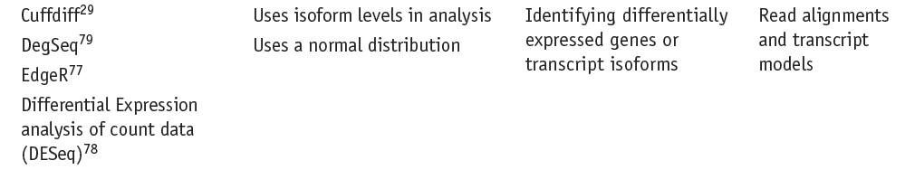
Differential Expression Tools
Garber, M., et al. (2011), Nature Methods, 8(6), 469–477.

Slide 64
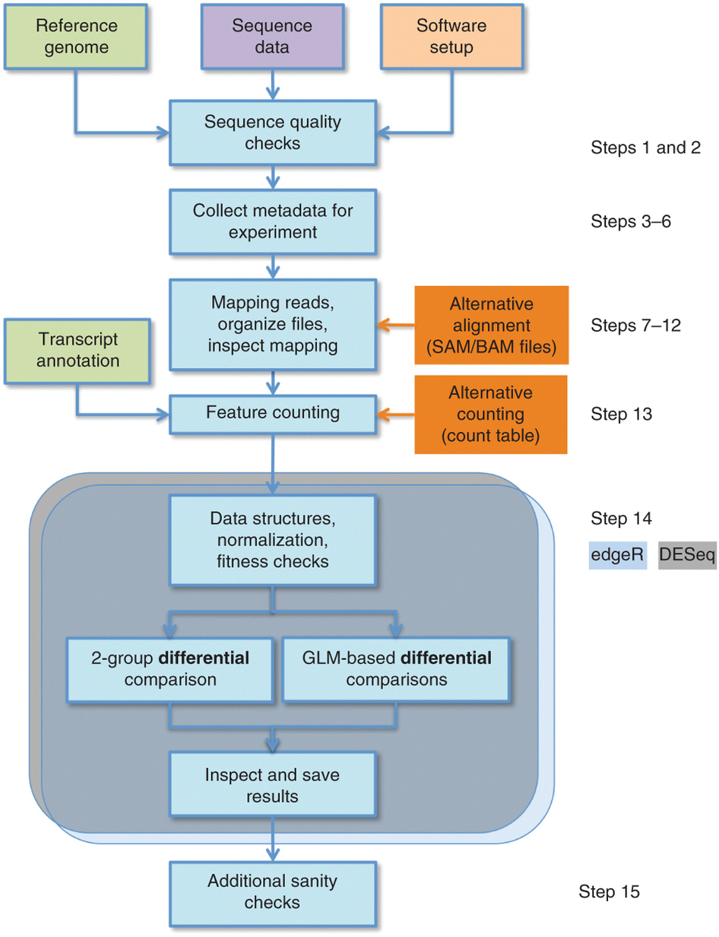
Alternative pipeline
Anders, S., et al. (2013), Nature protocols, 8, 1765–1786.

Slide 65
Differential gene expression analysis
Assumes that the number of reads in sample j that are assigned to gene i can be modeled by a negative binomial (NB) distribution,
K ~NB(_{ij} ,_{ij}²)
Estimates the variance by taking into account both the coverage within each library ("size factors"), the expression strength under each condition, and the per-gene variance.
Notes:
n practice, we do not know the parameters μij and  2 , and we need to estimate them from the data.
Count data follows a Poisson distribution. However, Poisson assumes that the mean equals the variance/dispersion (μ = σ2). However, in RNAseq data, genes with larger mean counts tend to show greater variance, which is described as the overdispersion problem.

Slide 66
DE analysis
Size factors
determined by comparing the ratio of gene counts between replicate experiments
Expression strength
determined by the mean counts for a gene for each condition.
per-gene variance
is assumed to be a function of the mean that is approximated by empirical fit to the data
Anders, S. et al., (2010). Genome biology, 11(10), R106.

Slide 67
DE analysis - Statistical test
p-values are calculated assuming that the probabilities follow a negative binomial distribution parametrised from the mean and the estimated dispersion.
p-values are adjusted for multiple testing
Hanna Lee, DESeq tutorial (http://cgrlucb.wikispaces.com/Spring+2012+DESeq+Tutorial
)
Notes:
are calculated through a method that is analogous to a Fisher's exact test, using a 2x2 contingency table, but instead of assuming that the probabilities follow a hypergeometric distribution, they

Slide 68
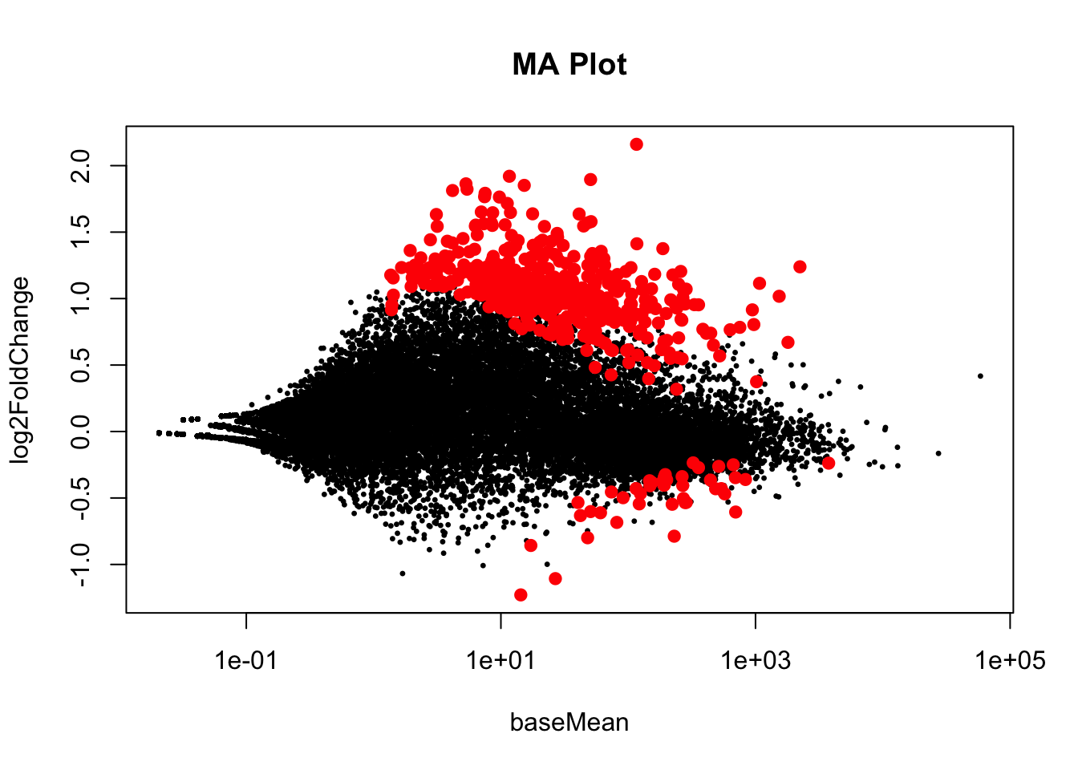
Plotting DE analysis outcome

Slide 69
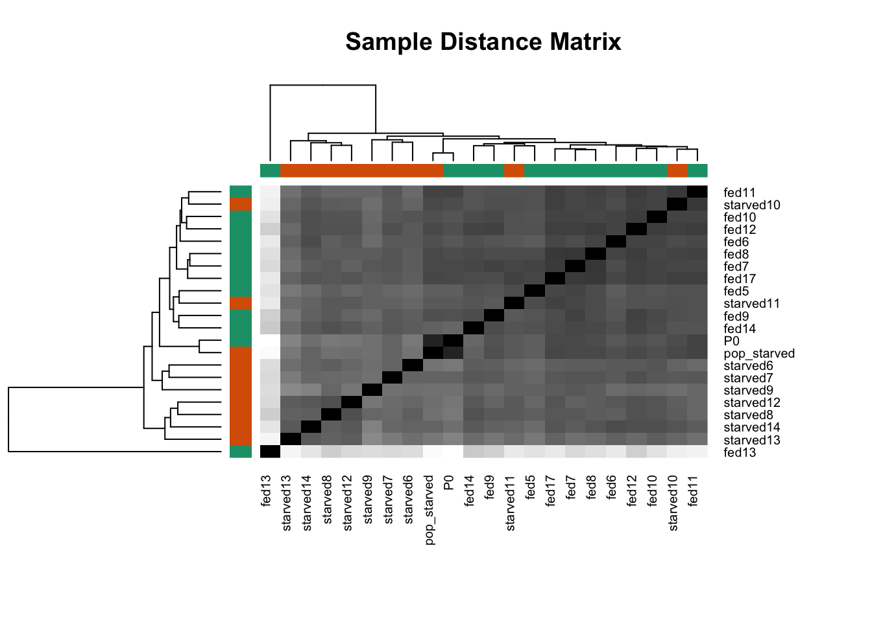
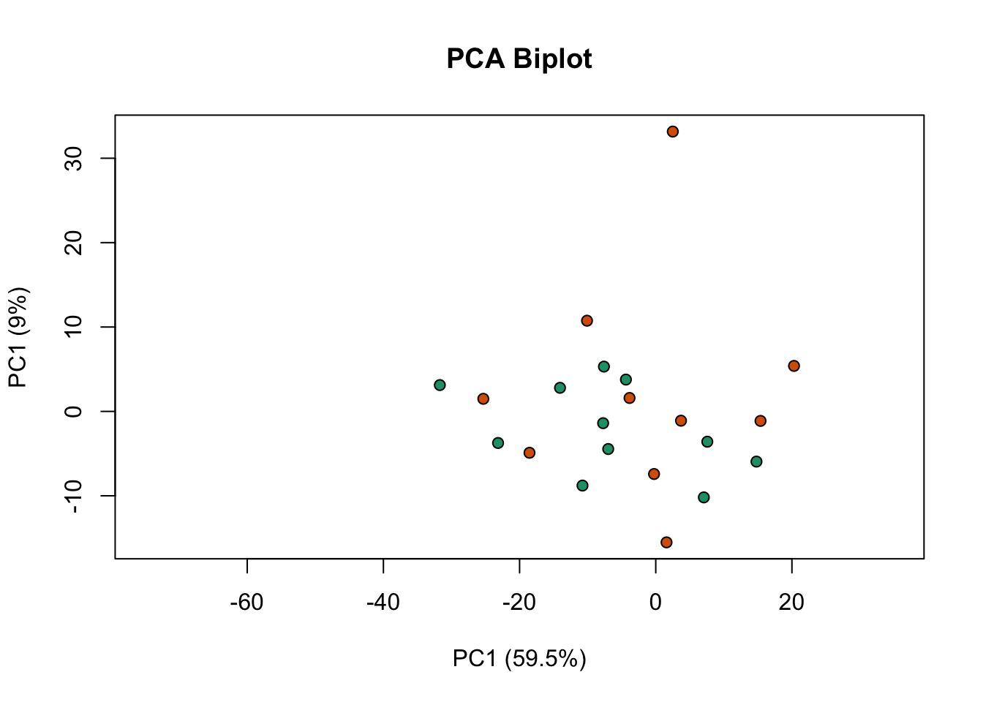
Outlier detection

Slide 70
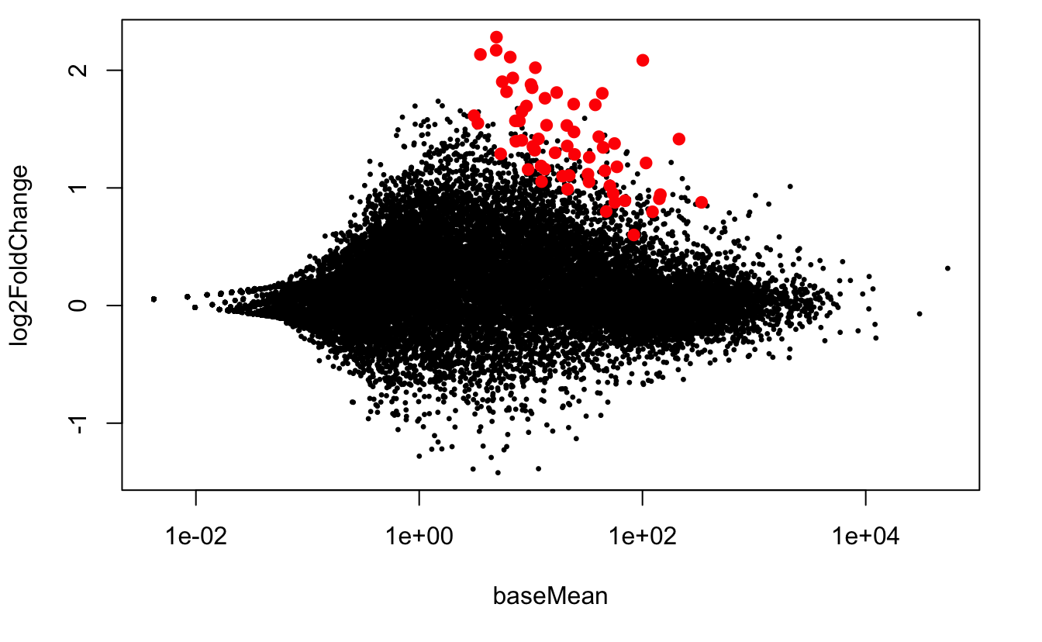
Outlier effect
With outliers samples
Without outliers samples

Slide 71
Differential Isoform Expression
Cuffdiff
http://cufflinks.cbcb.umd.edu/manual.html#cuffdiff
mmdiff
https://github.com/eturro/mmseq#mmseq-transcript-and-gene-level-expression-analysis-using-multi-mapping-rna-seq-reads

Slide 72
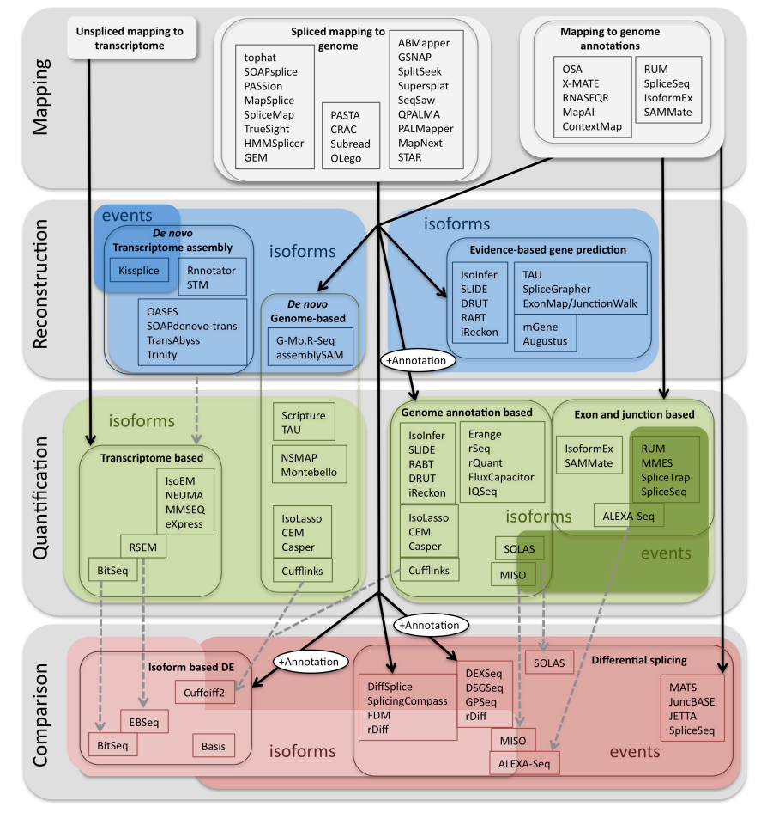
Methods to study splicing from RNA-seq data
Clifton, NJ., et al. (2014), Method in molecular biology, 1126, 357-97.

Slide 73
Multiple other applications
Allele specific expression
RNA editing
SNP analysis
Small RNA profiling …

Slide 74
How do I choose the right tool ?
Understand each tool’s requirements
e.g. MMSEQ requires alignment onto transcriptome
Identify how tools behave differently and pick one accordingly
e.g. Cufflinks (Mapping-first) vs. ABySS (Assembly-first)
Pick commonly used tools
cause there’s online help
..or tools implemented by someone in the lab/institute
cause you can always poke him when it doesn’t work

Slide 76
OTHER TOOLS
HISAT2
https://ccb.jhu.edu/software/hisat2/index.shtml
STRINGTIE
https://ccb.jhu.edu/software/stringtie/
KALLISTO
https://pachterlab.github.io/kallisto/
RAPMAP
https://github.com/COMBINE-lab/RapMap
SALMON
https://combine-lab.github.io/salmon/

Slide 77
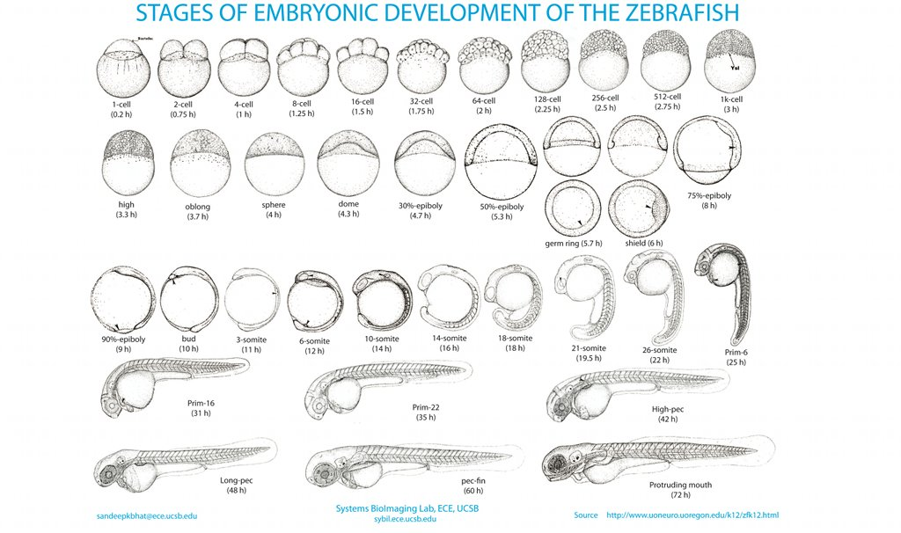
The hands-on design
VS
TRANSCRIPTOME COMPARISON OF
2 ZEBRAFISH DEVELOPMENT STAGES

Slide 78
FIRST PART (MORNING SESSION)
Genome alignment (TOPHAT)
Transcriptome reconstruction (CUFFLINKS)
Transcriptome quantification (CUFFLINKS)
Differential expression analysis (CUFFDIFF)
Functional interpretation of DE analysis results (DAVID)

Slide 79
SECOND PART (AFT.NN SESSION)
Alternative Pipeline
Alternative method for genomic alignment (STAR)
Read counts normalization and sample comparison
Differential expression analysis with DESeq2
Gene expression visualization (R)
Functional interpretation of DE analysis results (FIDEA)

Slide 80
Functional enrichment
The hypergeometric test calculates the probability that the number of genes in our gene list (e.g. the upregulated genes) are occurring in a functional Category/pathway more than expected by chance
Functional
annotation
Testing gene list
Gene universe

